Slide 1
Streaming Data Analysis using Apache Spark for breaking news on twitter
Michael Kitis
Notes:
bad title for this presentation because we will talk for much more :)
However, before we get there I will also present you a classic implementation of data mining in social media using static data
The reason for this mess is that I don’t think you need to learn anything specific from this presentation I am sure that you can learn by your own anything you want, you can learn how apache spark works for example,
my intentions are to inspire you and hopefully you can leave this room in an hour with new ideas which I would be happy if you can share them as well before leaving :).

Slide 2
Intro

Slide 3
Intro
We will talk about
Social Media APIs
Data Mining
Apache Spark
Target
Data Mining using Twitter API
Static data
Streaming data
Notes:
So we will talk about …
Social media APIs is a way to retrieve data from social medial
Data Mining refers is the process to discover patterns in data using DBs, maschine learning and statistics
Apache spark is a framework for data mining in big datasets and streaming data.
And as I said two types of data mining static data and streaming data

Slide 4
Theoretical Background
Notes:
Some theory :(

Slide 5
Theoretical Background
Data Collection
Twitter
APIs
JSON
Data Analysis
DataBase (schema)
Data Mining (patterns)
Big Data
Notes:
I collect data from Twitter which is a playground for people like us, people who like gettting data from the web and discover something more in them
API that stands for
Application programming interface. Is just a set of protocols a way to communicate with Twitter DB and retrieve tweets, massive amount of tweets, old tweets a flow of tweets for a specific hashtag for example
JSON is the usual way we collect the data from an API. Just a text file with some structure because structure is very important in our field.
Speaking about structure I want to try give you a personal perception of what is Data Analysis. In my opinion this started with DBs. We used to have a lot of data but no way to retrieve them fast so we needed to organise them. and DB is that , DB Is just a collection of data but with a very important property the Schema. Schema is what make a DB retrieve data fast and effiient.
DBs are important of course but we discover that data contain more information so we start finding patterns in data and in Data mining patterns is equal with knowledge (milk example )
And today we find these patterns in huge amount of data Big Data. Important patterns and knowledge can be found if you have big amount of data like fraud detection in the banking system and more importantly built systems that can distinquish cancer cells from normal cell in Bioinformatics

Slide 6
Data Mining on Twitter using Static Data
Notes:
The first of the two projects that I will present today

Slide 7
Voter Approach Tool
Data
Greek political parties - Parliamentary elections January 2015
Follower for each political party on Twitter
Multiple Datasets
Data Visualisation
Information
Polling Tool
Voter Approach tool
Notes:
Source Greek elections
My data where the followers of each greek political party before the elections
Multiple Datasets -> retrive data for the last days before the election
Visualize them
Try to do a polling tool and most important voter approach tool which could be useful for greek political parties to approach voters that follow them on twitter but they where also follow another party.
For example if argyris has only one vote in the election but he may follows two political parties on Twitter so political parties should approach him convince him and make sure that he will vote for them :)
So I found the common followers and try to visualise the whole think

Slide 8
System Architecture

Slide 9
Implementation Steps
Retrieve and store data (retrieval.py)
Political Parties Followers (88.647)
Data Processing (analyze.py)
Common Followers between political parties
Visualise
Statistical data
Failure
Second Layer Followers
Notes:
Using twitter API I retrieve all the followers for the 7 main political parties in greece
Find the common followers - visualize them and extract some statistic data
Second layer, the reason was to exract some information about the followers as well. The information that I have extract was how many followers did they have, with that I tried to find out which political party has the most socialy active followers.
Its common in data mining to searching for somehting Sometimes you find nothing sometimes you find what you want and sometimes you finds nothing like life :)

Slide 10
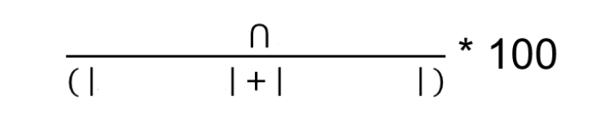
Results – Common Voters
PartyA
PartyB
PartyA
PartyB
 | ΣΥΡΙΖΑ | Νέα Δημοκρατία | ΠΑΣΟΚ | Το Ποτάμι | Χρυσή Αυγή | ΑΝΕΛ | ΚΚΕ
ΣΥΡΙΖΑ | - | 20.61% (8558) | 19.28% (8004) | 8.96% (3719) | 2.70% (1120) | 6.05% (2512) | 1.78% (739)
Νέα Δημοκρατία | 37.72% (8558) | - | 44.85% (10174) | 14.49 % (3287) | 6.34% (1439) | 10.55% (2394) | 1.69% (384)
ΠΑΣΟΚ | 47.09% (8004) | 59.85% (10174) | - | 17.43% (2962) | 6.40% (1088) | 11.94% (2029) | 2.22% (378)
Το Ποτάμι | 28.99% (3719) | 25.62% (3287) | 23.09% (2962) | - | 3.12% (400) | 8.76% (1124) | 1.24% (159)
Χρυσή Αυγή | 17.58% (1120) | 22.58% (1439) | 17.07% (1088) | 6.28% (400) | - | 11.27% (718) | 1.40% (89)
ΑΝΕΛ | 44.63% (2512) | 42.54% (2394) | 36.05% (2029) | 19.97% (1124) | 12.76% (718) | - | 2.88% (162)
ΚΚΕ | 37.88% (739) | 19.68% (384) | 19.37% (378) | 8.15% (159) | 4.56% (89) | 8.30% (162) | -
Notes:
In this table you can see the percentage of the common followers
cardinality number of element in the dataset

Slide 11
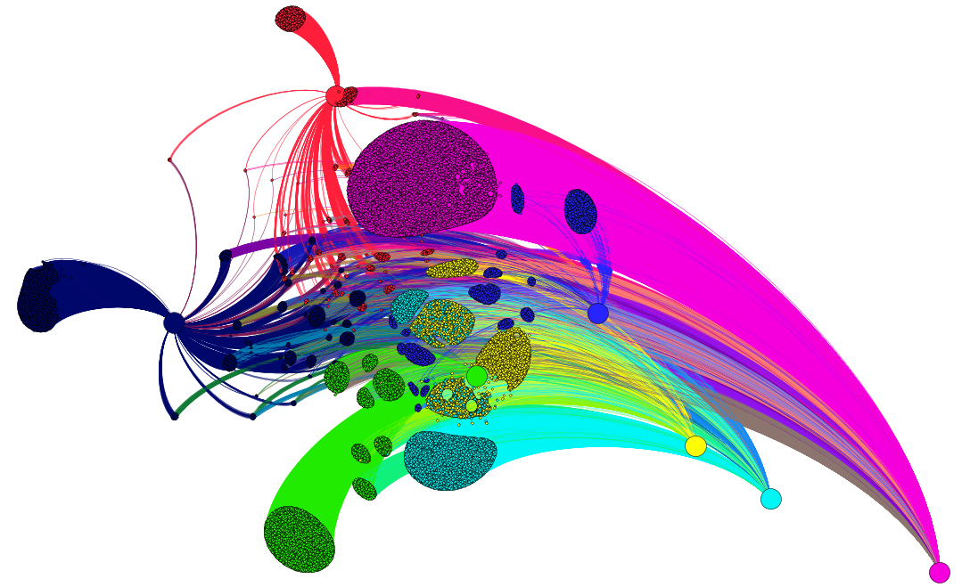
Visualise Common Voters
Notes:
Modularity gia entopismo geitoniwn
Force atlas
GEPHI

Slide 12
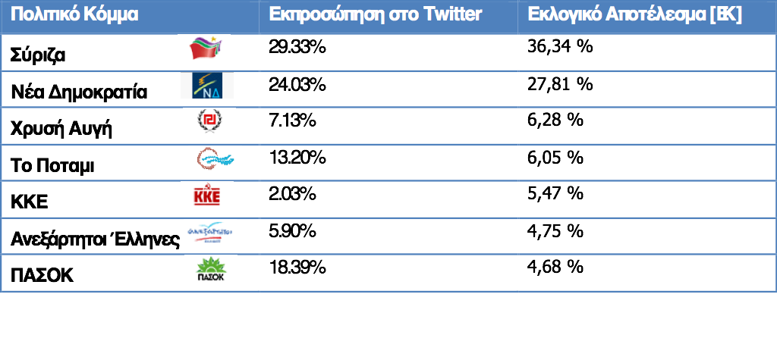
Evaluation
Part of the information was used in order to evaluate results
Political Party Twitter Election Results [EK]
Notes:
In data mining we should always evaluate our data. Here is mine.
I evaluate my data with the real results and I found that I was close to some partis and far from other so Pasok for example way out, I I did it again I would retrive not all followers but the followers that follow the party recently.

Slide 13
Data Mining on Twitter using Streaming Data
Notes:
A more “modern” approach of data analysis

Slide 14

Apache Spark
Notes:
Apachr spark is a framework of Handoop so Before we talk about Spark we should say some things about Handoop

Slide 15
Apache Hadoop
The first revolutionary approach to managing large volumes of data on a cluster of computers
HDFS
Map Reduce
Notes:
The first revolutionary approach to managing large volumes of data on a cluster of computers
Handoop is an open source library written in Java which solves problems of huge amount of data split in Clusters. Two basic technologies that it uses is Hadoop Distributed File System (HDFS) and Map Reduce which both start in google
What is HDFS and what is Map Reduce

Slide 16
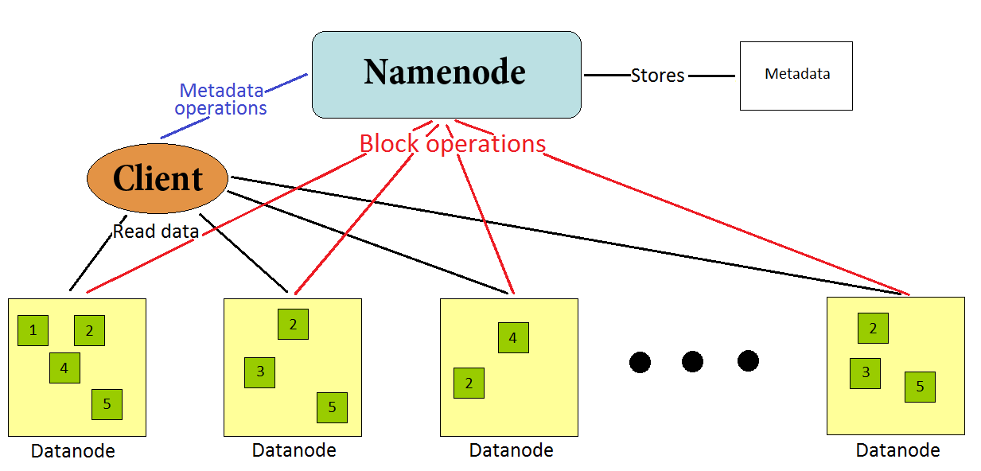
Apache Hadoop
HDFS
Notes:
Is a a filesystem architecture, filesystem is a way to store and receive data like file explorer in Windows but with the difference that it handles huge amount of data.
This small difference is quite important among other reasons its important because of the failures.
HDFS retrives data from HDD. For example a HDD crush 1 in 1000 days so if you have one HDD to access you are safe but if you have 1000 of them then you have 1 failure per day. HDFS handles this by making copies of data in separate HDDs and also fast….
Hard disk failure is a daily issue in google not in a personal pc of course

Slide 17
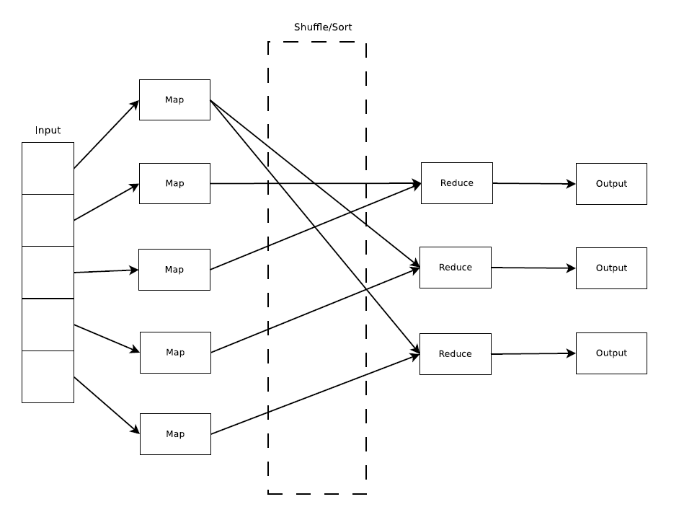
Apache Hadoop
Map Reduce
Notes:
Map Reduce is the computational model of Handoop for processing big amount of data
It handles key-value pair data which are stored in HDFS
Map reduce split the initial problem in smaller indepentant problems and process them in parallel
The final results are combined process again and eventually give the final result of the initial big problem
Thats all about Handoop..

Slide 18
Apache spark
Spark Vs Hadoop
Spark Ecosystem
Spark Streaming
Spark ML
Spark Architecture
Spark Data Structures
Rdds
Data Frames
Notes:
Apache spark is a framework of Handoop that simplify the process and succeeds faster computation times.
Spark started in 2009 at Barkeley university and latter on it became open source software and donate at Apache software foundation
Its written in Scala and supports programs written in Java, Scala, R and Python
Comparing with Handoop is much faster, 100 times faster, I will reveal the reason in the next slide but you can easily guess the reason, its 100 times faster
Spark has an ecosystem that contains among other libraries Spark Streaming and Spark ML that I used for this project
We will talk a little bit about Spark arcitecture and also about its data structures
So did you guess why its 100 times faster?

Slide 19
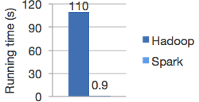
Apache Spark
Spark Vs Hadoop
Notes:
Spark is way faster that Handoop and the reason for that is that Sparks does not work with HDD. Spark runs in physical memory RAM

Slide 20
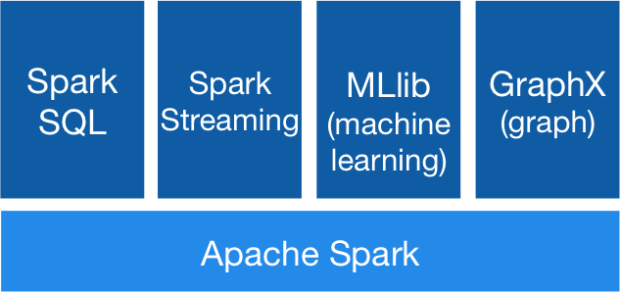
Apache Spark
Spark Ecosystem
Notes:
Spark ecosystem consists of high level libraries like..
Spoark SQL< SPOARK STREAMING ML and graphX
I used Spark Streaming and ML library

Slide 21
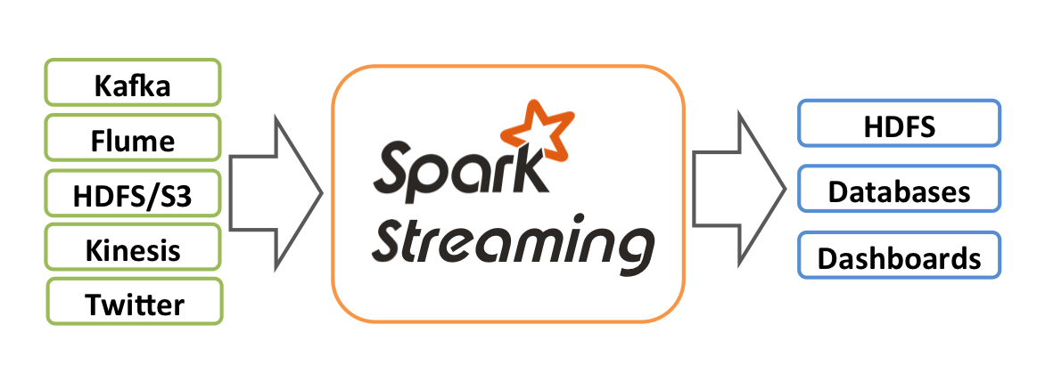
Apache Spark
Spark Streaming
Notes:
Spark Streaming can work with streams from DBs, HDFS, Twitter, a tcp token etc
In my implementation I used a TCP socket as a streaming source which sends JSON files from twitter

Slide 22
Apache Spark
MLlib
Part of the Apache Spark framework
Machine Learning algorithms
Classification: logistic regression, naive Bayes
Regression: generalized linear regression
Decision trees, random forests
Clustering: K-means, Gaussian mixtures (GMMs)
Much More…
Notes:
MLib of Spark contains machine learning algorithms that you can use to solve problems. These algorithms work with RDDs data structure.
MLib will be replace with ML library which uses data frames a different data structure that has better performance.
Currently both libraries exist in Spark

Slide 23
Data Structures
RDDs (Resilient Distributed Datasets)
Implements map – reduce
Transformation - Action
Data Frames
Combines the advantages of RDD and SQL table data structure
Notes:
So what is an RDDs is a data structure that implements map reduce and transormations
Data Frame Is aslo a data strucrture that combines the advantages of RDD and an sql tasble

Slide 24

Apache Spark
Spark Architecture
Notes:
Something very important is that Spark can run on your PC! Handoop cannot
Spark runs on every thread of your processor
Master Slave architecture

Slide 25
Streaming Data
Notes:
In the first project with political parties we use static data we extract some statistic results and latter on we visualise them
Now we will use Apache Spark in order to handle data flows from twitter.

Slide 26
Streaming Data
Streaming Data of Breaking News in real time
Big Data Amount - 1000 json/min
Parallel Processing
Improving Knowledge over time
Use Information while generating
Notes:
Streaming Data of Breaking News in real time
…
I was receiving 1000 json/min 5mb

Slide 27
Streaming Data of Breaking News in Real Time
The number one reason for people accessing Twitter is to be alerted for Breaking News [HT]
Use tweets that contain the hashtag #news
Find the most important news in real time
Notes:
Why news

Slide 28
System Architecture

Slide 29
Implementation Steps
Data Collection
Data Analyse
Spark Streaming
Selection
Preprocessing
Transformation (tokenize)
Stop word remover
Word count
Store/Update Results in DB
Keep Collection, Analyse and Update Data
Notes:
Selection: keep text only for each tweet
Preprocessing: Remove links slashes dots etc
Transformation: Create a Data Frame which contains a tweet
Remove stop words
Count words

Slide 30
Sample Results
# | word | count
1 | suicide | 14439
2 | medina | 12810
3 | saudi | 11791
4 | city | 9910
5 | mosque | 7842
6 | prophet | 6401
7 | want | 6313
8 | new | 4445
9 | vote | 2813
10 | life | 2746
11 | islam | 2154
12 | best | 1655
Date: 4/7/2016 20:00-22:00
Number of tweets: 196973
RT: 63622

Slide 31
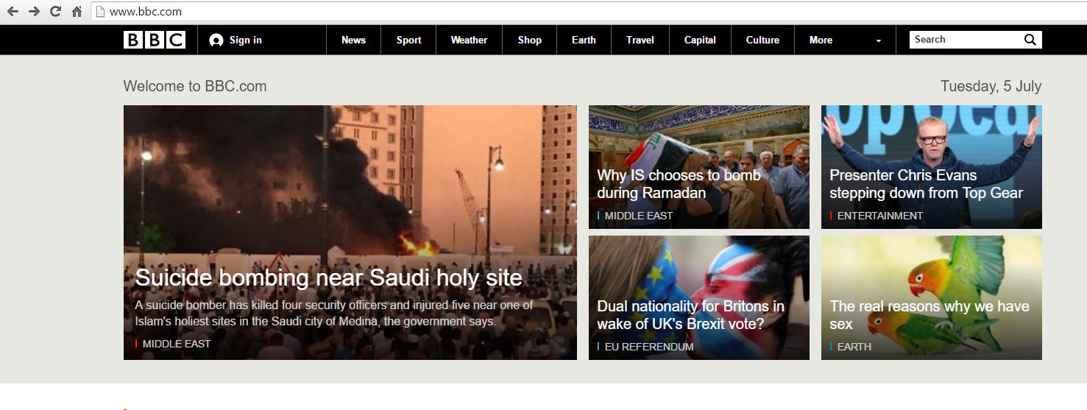
Results Evaluation
Suspected suicide bomb blast near Prophet’s Mosque in Madina

Slide 32
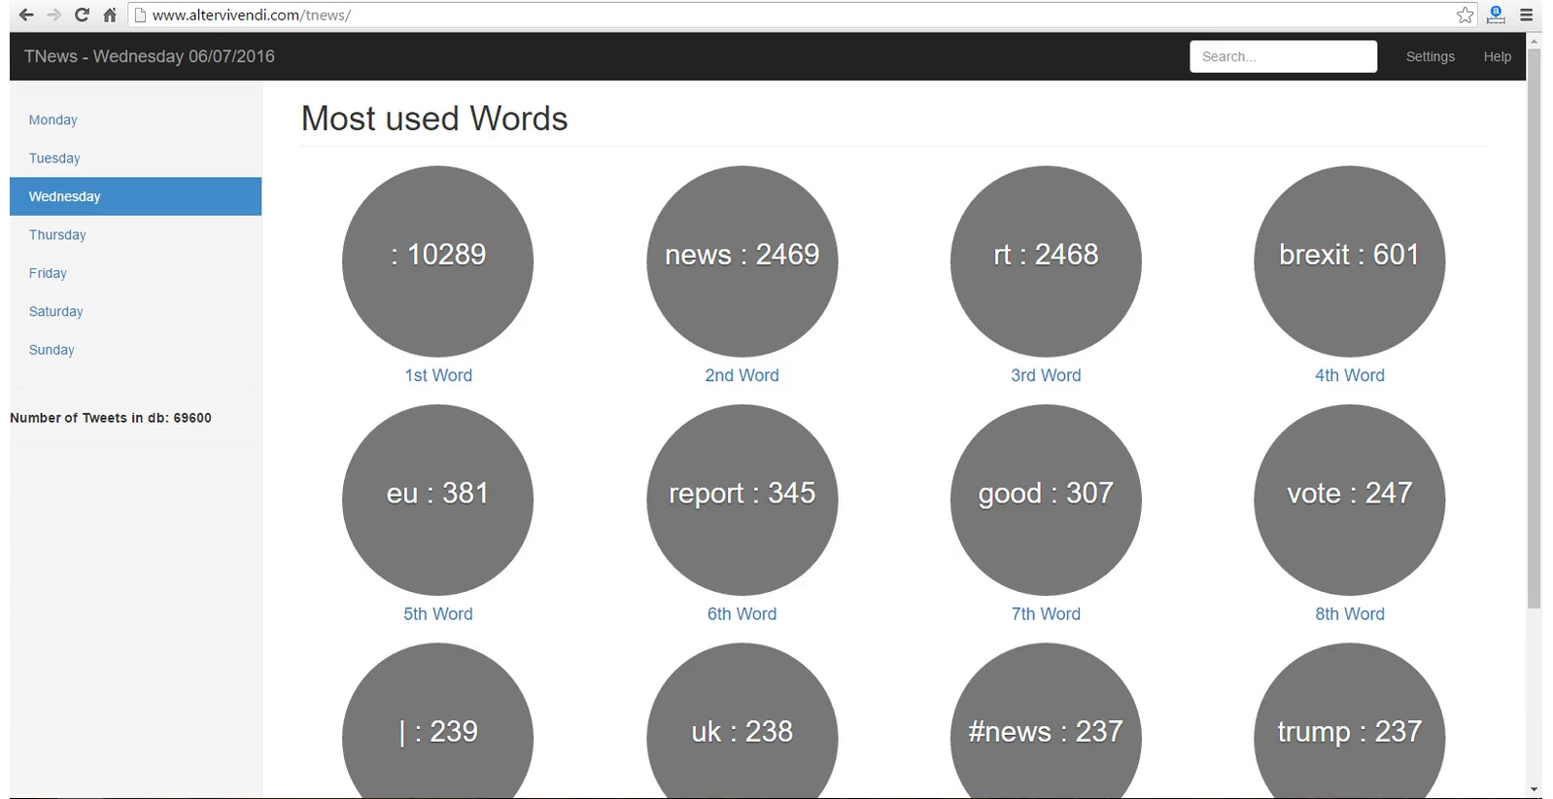
News and Information Tool

Slide 33
Conclusions
Data Mining in Social Networks
Wide Variety of Applications
New Possibilities - data streaming
Machine Learning algorithms should be implement to work in new environments - dynamic data
Data Structure ex. Data Frames
Computation Model ex. Map reduce

Slide 34
A Good Start
Data Mining
Chapter 9: Twitter CookBook

Slide 35
References
[1] Andreas Kanavos, Isidoros Perikos, Pantelis Vikatos, Ioannis Hatzilygeroudis, Christos Makris, and Athanasios Tsakalidis, Modeling ReTweet Diffusion Using Emotional Content
[2] LEKHA R. NAIR, DR. SUJALA D. SHETTY, Streaming Data Analysis Using Spark For Effective Job Search (2015)
[3] Matthew A. Russell, Mining the Social Web, 2nd Edition, O'Reilly Media
[4] Yuheng Hu, Shelly Farnham, Kartik Talamadupula, Predicting User Engagement on Twitter with Real-World Events
[5] Nikolaos Nodarakis, Spyros Sioutas, Athanasios Tsakalidis, Giannis Tzimas, Large Scale Sentiment Analysis on Twitter with Spark
[6] Advanced Analytics with Spark by Sandy Ryza, Uri Laserson, Sean Owen, and Josh Wills (O’Reilly). Copyright 2015 Sandy Ryza, Uri Laserson, Sean Owen, and Josh Wills, 978-1-491-91276-
[7] Sanjay Ghemawat, Howard Gobioff, Shun-Tak Leung, The Google File System
[8] Jeffrey Dean, Sanjay Ghemawat, Map Reduce: Simplified Data Processing on Large Clusters
[9] Takeshi Sakaki, Fujio Toriumi, Yutaka Matsuo, Tweet Trend Analysis in an Emergency Situation
[10] Vincent D. Blondel, Jean-Loup Guillaume, Renaud Lambiotte, Etienne Lefebvre, Fast unfolding of communities in large networks
[11] Mathieu Jacomy, Tommaso Venturini, Sebastien Heymann, Mathieu Bastian, ForceAtlas2, a Continuous Graph Layout Algorithm for Handy Network Visualization Designed for the Gephi Software

Slide 36
References
[HT] https://www.americanpressinstitute.org/publications/reports/survey-research/how-people-use-twitter-in-general/
[ST] statista.com
[SB] statisticbrain.com
[BD] http://bigdatauniversity.com/blog/analyze-social-media-data-real-time/
[TR] http://trends24.in/
[EK] http://ekloges-prev.singularlogic.eu/v2015a/v/public/index.html
[GZ] http://gizmodo.com/how-much-happens-on-the-internet-every-60-seconds-950463150
[IN] http://www.inscribd.com/21-amazing-facts-about-the-internet/#axzz3WEjg4W1G
[SW] http://ir.dcs.gla.ac.uk/resources/linguistic_utils/stop_words
[TSA] Twitter Streaming API documentation, https://dev.twitter.com/streaming/overview
[TPA] Twitter Public API documentation, https://dev.twitter.com/rest/public
[ BBC ] www.bbc.com

Slide 37
Questions
?

